Slide 1

KauN banega crorepati
Advance Programming Lab Project
Created By :
Priyansh Agrawal (2014UCP1388) Shubham Singhal (2014UCP1420)

Slide 2
Functions | Work
LoadImage | Load the images into buffer
key_func | To use different keys
draw_option | Draws option on screen
audiencePoll | Lifeline function
fiftyFifty | Lifeline function
createSubWindow | Create a pop-up on screen
timer | To show the timer
playSound | For background music
mouseline | To use the mouse
idle3 | To load the question window
display | Display on screen
show_menu | To show menu
show_background | To show background images
Class | work
User | To implement user functionality

Slide 3

Starting Window

Slide 4
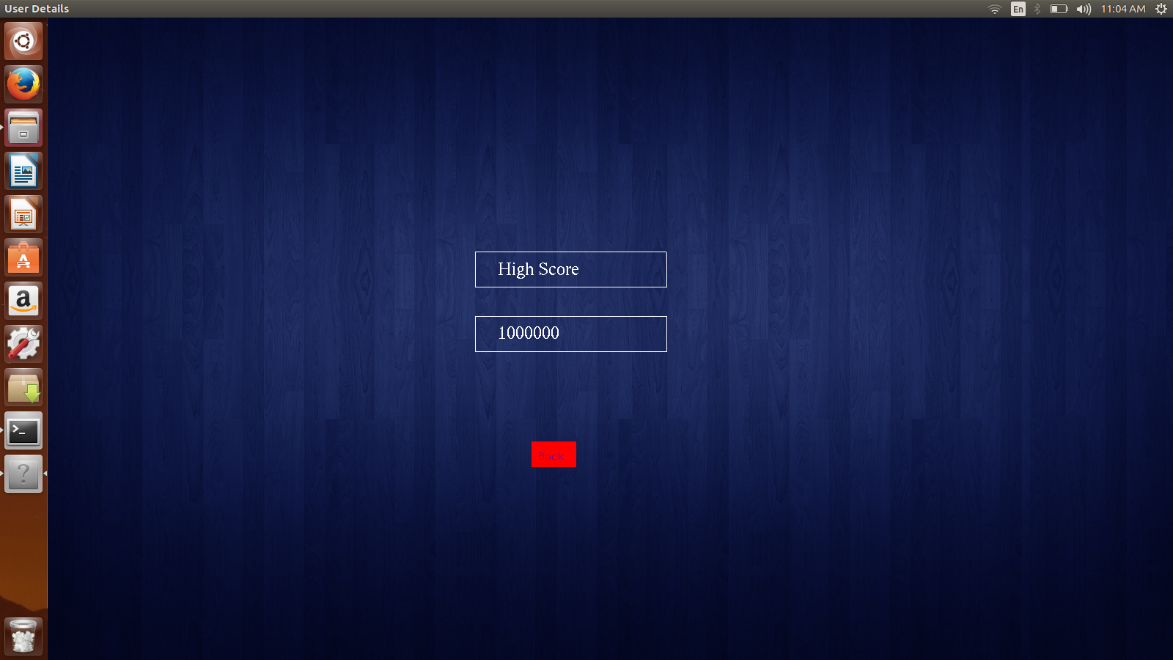
High score Window

Slide 5
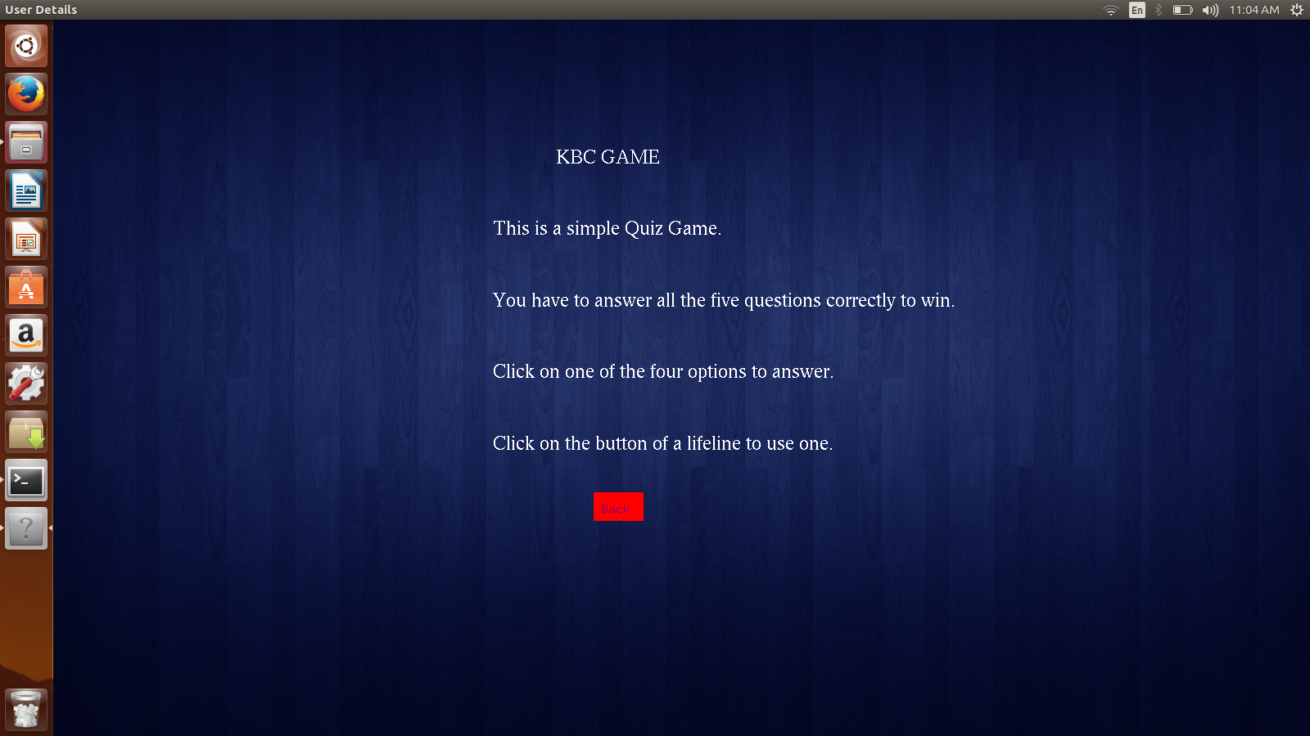
Tips to Play

Slide 6
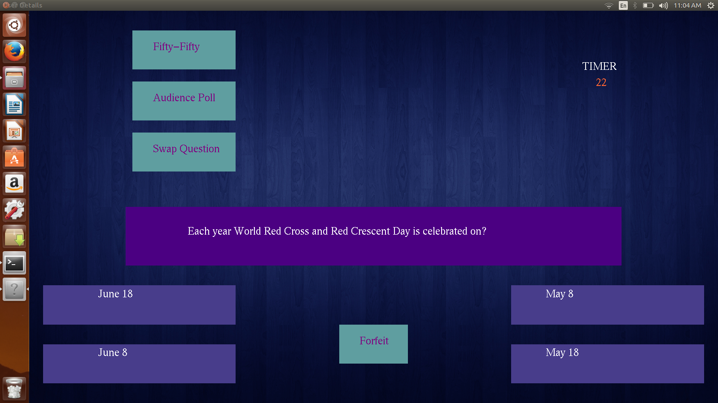
Question Window

Slide 7
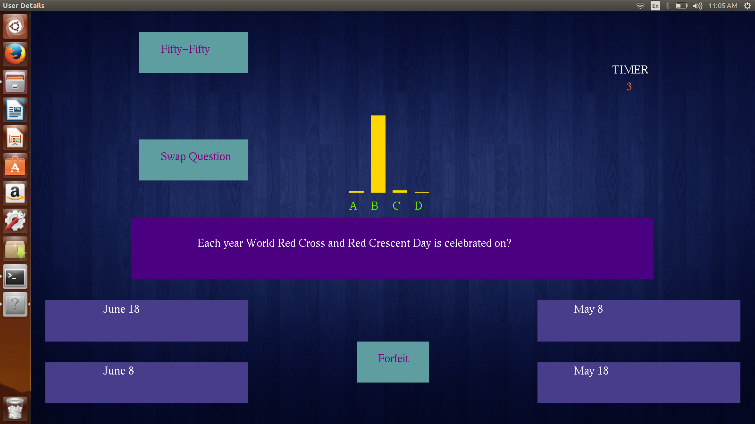
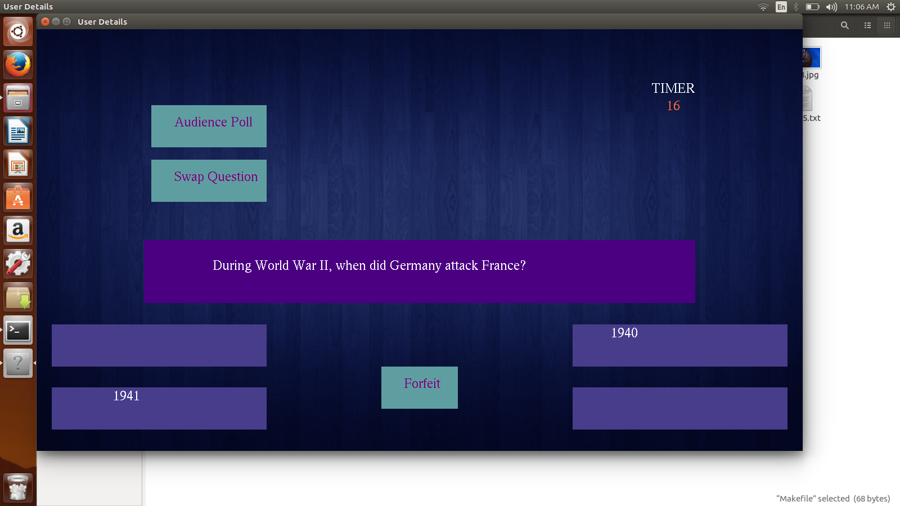
Use of Lifelines

Slide 8
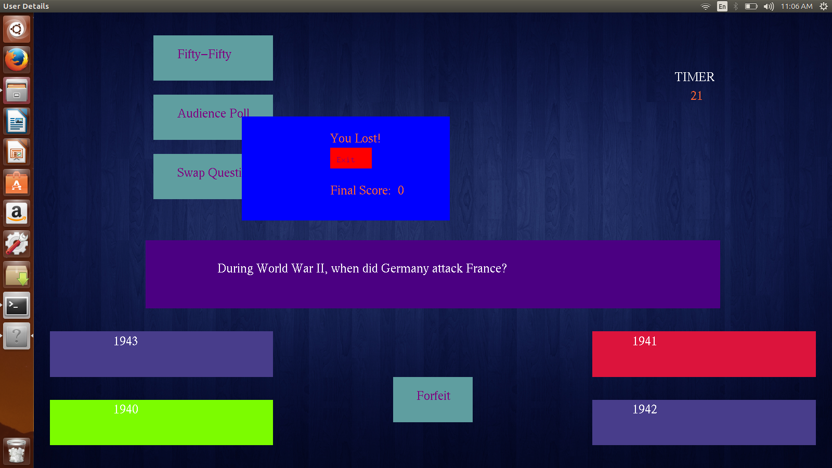
Clicking Wrong Option

Slide 9
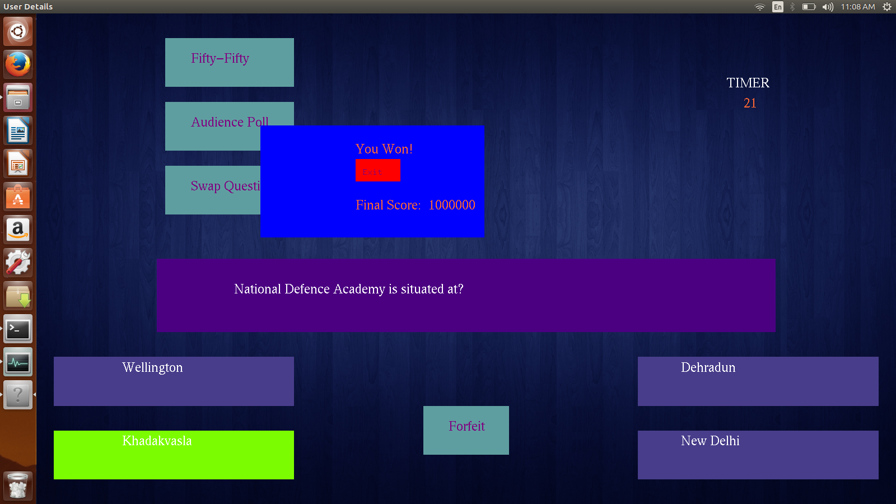
On Answering every Question

Slide 10


